Slide 1
DICOM: Testament of Time
David A. Clunie (PixelMed)
dclunie@dclunie.com
2021/12/14
ESMRMB: MRI Together workshop

Slide 2


Speaker name:
Dr David A. Clunie, PixelMed
Conflicts of interest regarding this presentation:
Editor, DICOM Standard (NEMA contractor).
Various academic and commercial consulting contracts as DICOM SME.
© David A. Clunie.
This presentation is released under a CC-BY license.

Slide 3


Format
http://en.wikipedia.org/wiki/More_Than_a_Feeling

Slide 4
What is DICOM?
Open standard
Specification for interoperability
Protocol for messaging and transport
Services for storage and management
Metadata encoding mechanism
Information object definition
Information model (reflected in metadata)
Pixel data encoding mechanism (including lossless/lossy compression)
Application functionality specification and conformance mechanism
Annotation, rendering and reporting mechanisms

Slide 5
Open Science needs Open Standards
DICOM is Open:
publicly available and freely accessible (no fee to download, unlike ISO standards)
freely readable (source written in open format XML DocBook)
free to use (no license fees to implement, no commercial restrictions, no agreement)
free of (known) external IP restrictions (theoretically procedures allow RAND not FRAND, but so far all no cost)
free to extend (private elements, SOP Classes) (non-viral)
free to participate and contribute to (though membership fee required to vote)
http://en.wikipedia.org/wiki/Open_standard
High quality open source reference libraries and utilities freely available:
dcmtk (C++)
dcm4che (Java)
pydicom (Python)

Slide 6
Interoperability – Definition
“the ability of two or more systems or components to exchange information and to use the information that has been exchanged”
IEEE Standard Computer Dictionary: A Compilation of IEEE Standard Computer Glossaries. 1990

Slide 7
DICOM Services – circa mid-90's
Print
Laser Printer
Print
Store
Store
Q/R
MR Modality
Workstation
Q/R
Store
Storage Commitment
Shared Archive

Slide 8


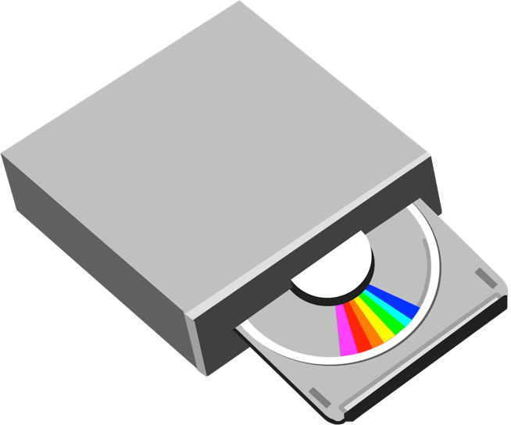
DICOM Network and Media
Store
Store
Modality
Workstation
PC
Media
Media
What Encoding?
Which Medium?
,
, ...
,
, ...

Slide 9
Why is DICOM the way it is?
Who was/is the customer?
turnkey clinical device purchaser
Who decides?
what goes in medical imaging device products
When did it start?
product of the eighties – consequences

Slide 10
Who?
Who is supported by the standard?
clinical radiologist
referring clinician
research radiologist
research scientist, engineer, physicist, etc.
clinical trialists
vendor engineers
Different users have different requirements
(near) plug and play, high throughput, managed services, patient oriented, safety
technically sophisticated, manual effort, file-oriented, research focus, specific needs
allowing for innovation -> extensibility -> (transient) reduced interoperability
Who decides?
vendor product managers allocate engineering resources
focus is almost exclusively clinical – those who buy scanners, workstations, PACS, …

Slide 11
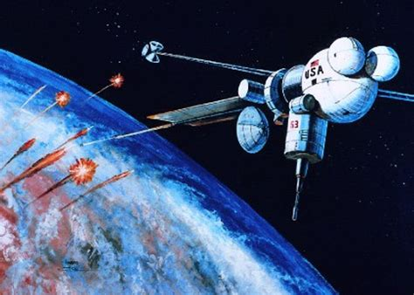

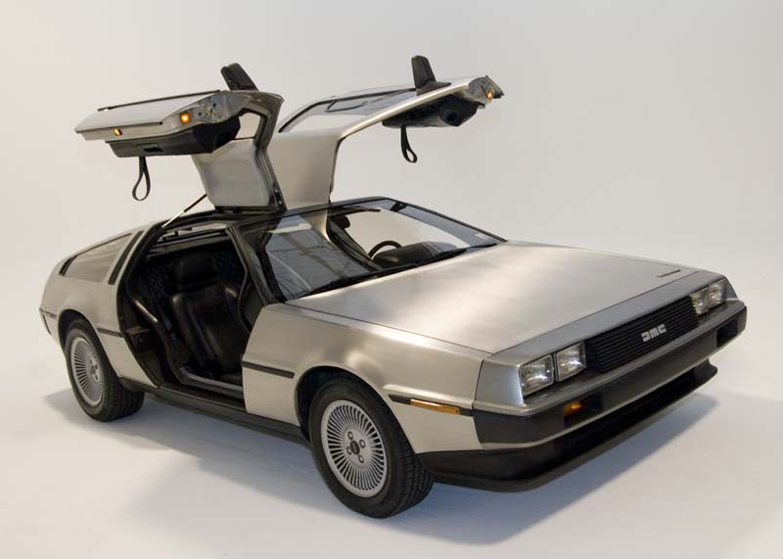
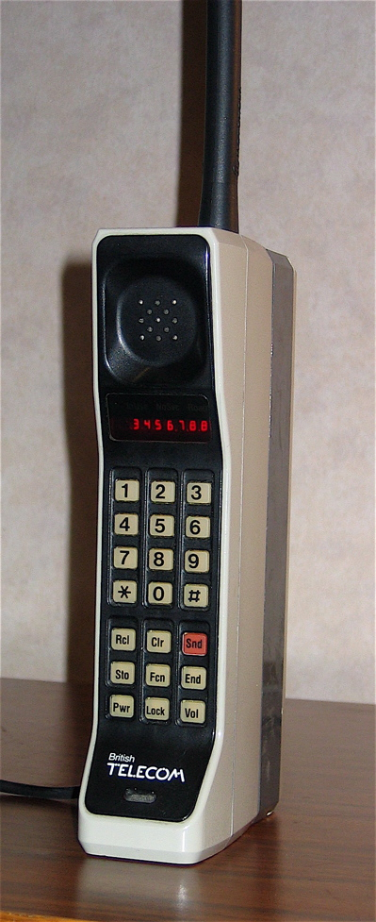

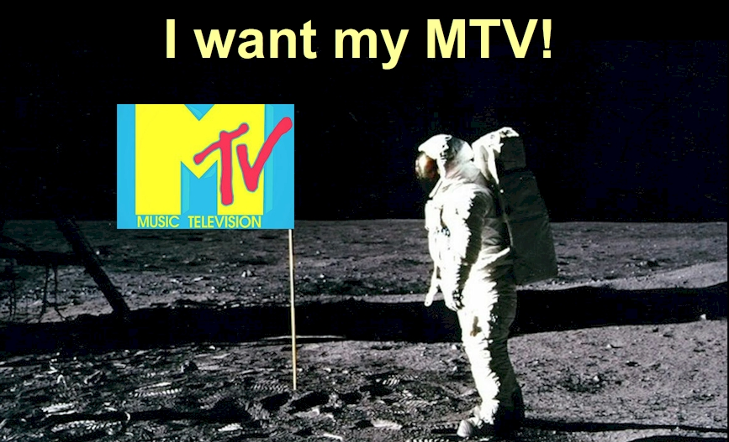

Slide 12
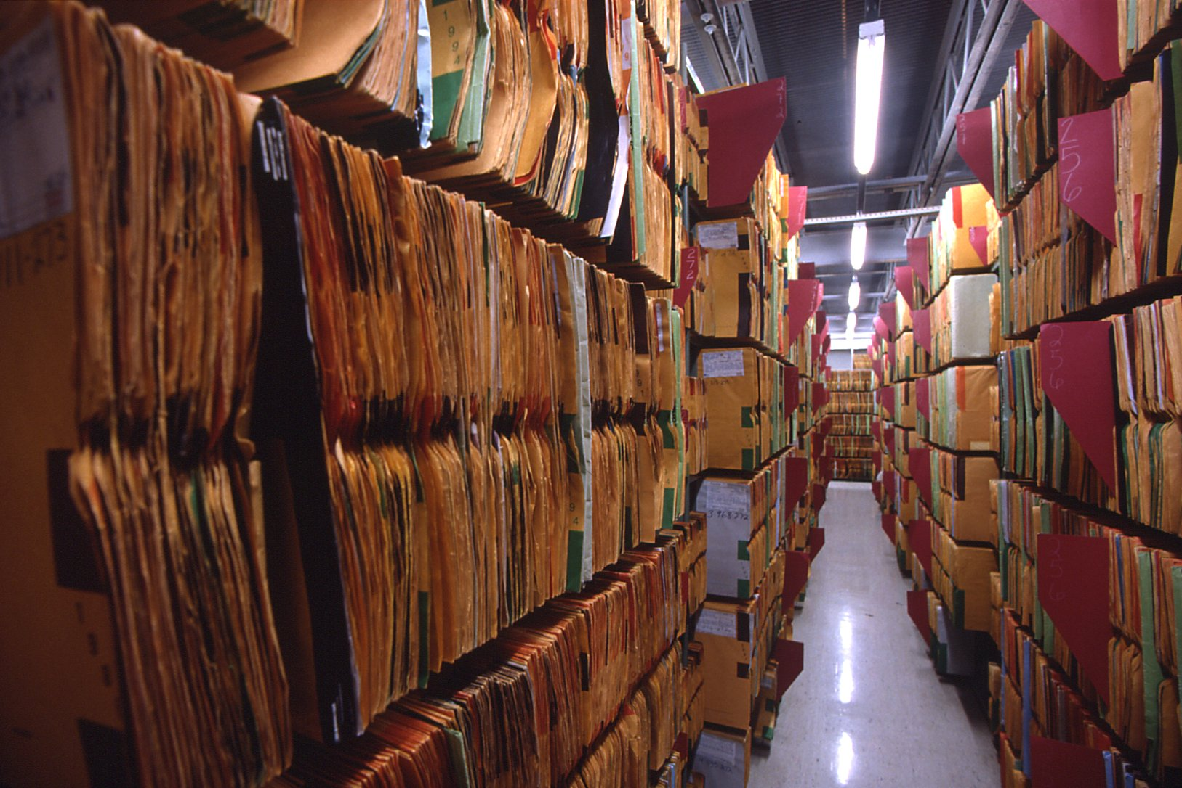
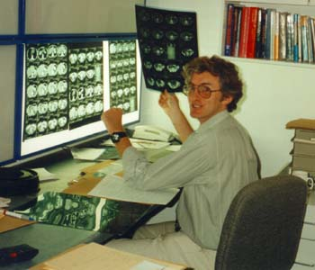

Slide 13
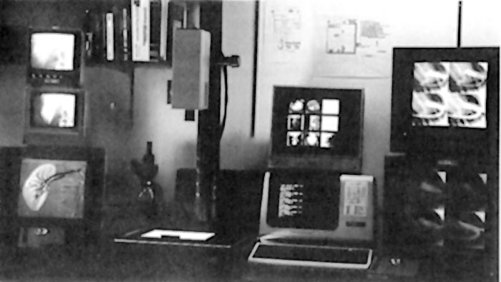
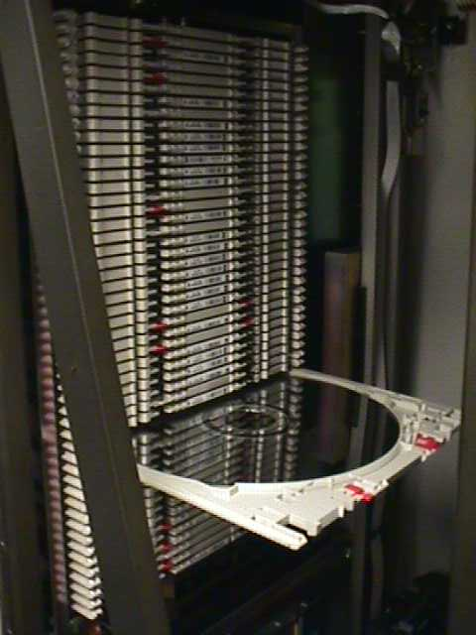
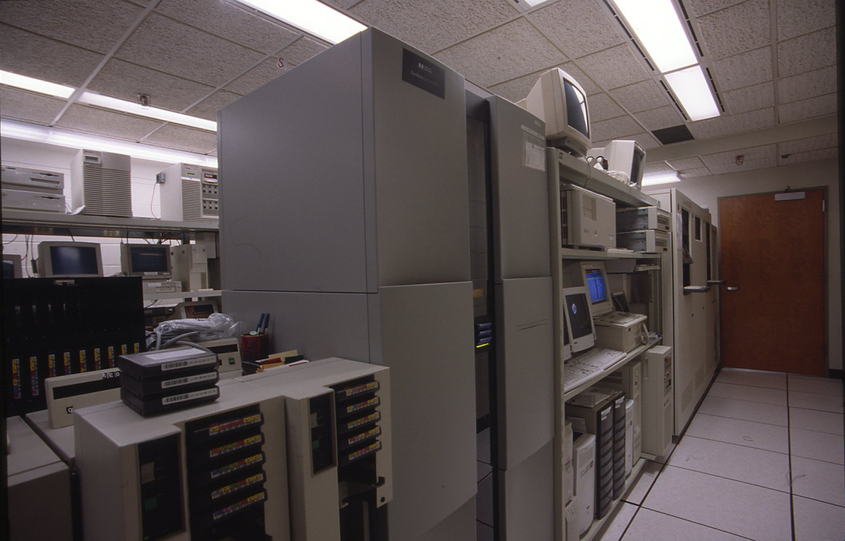
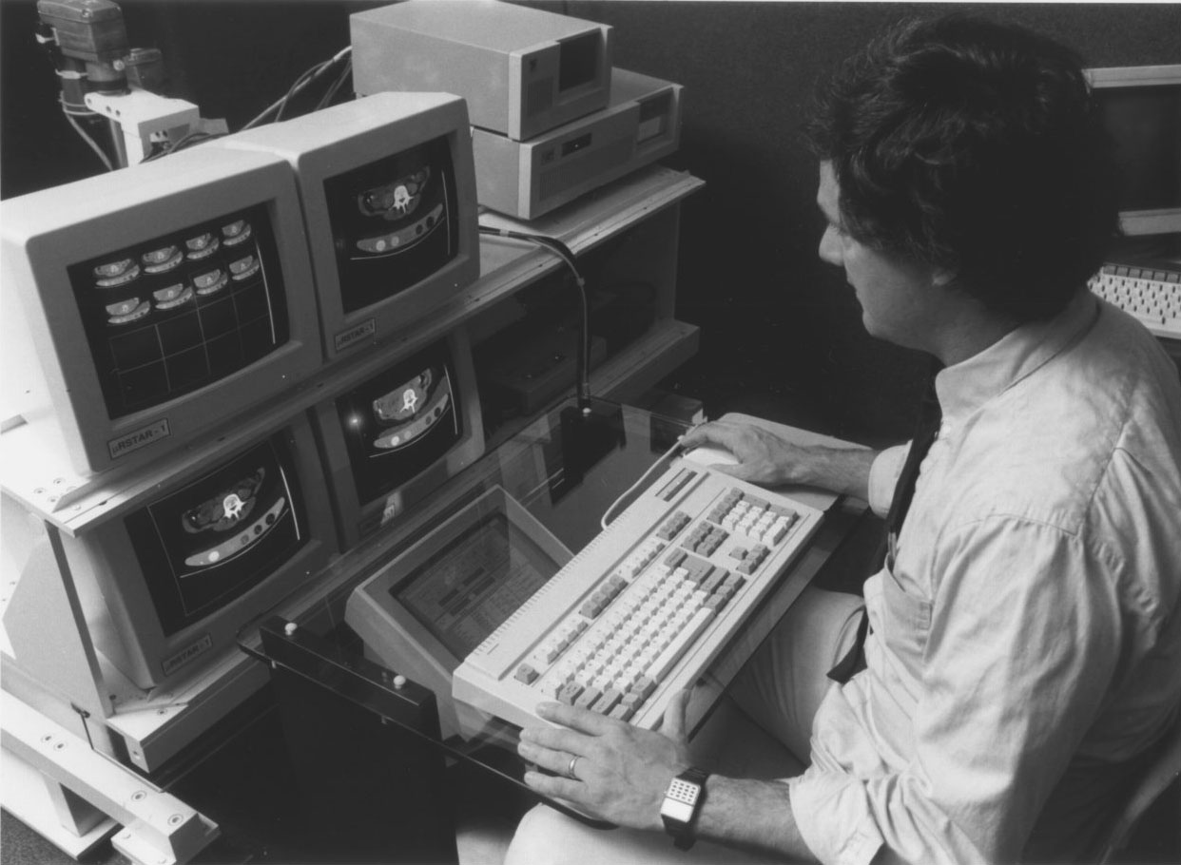
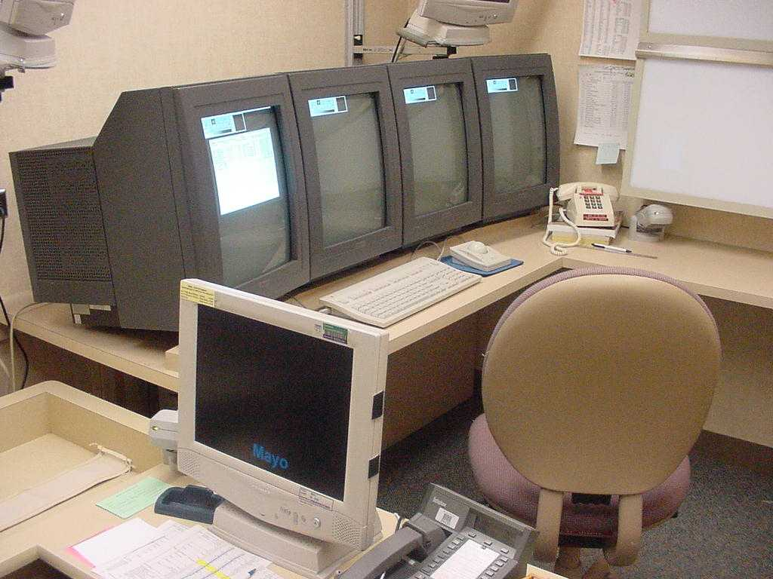

Slide 14
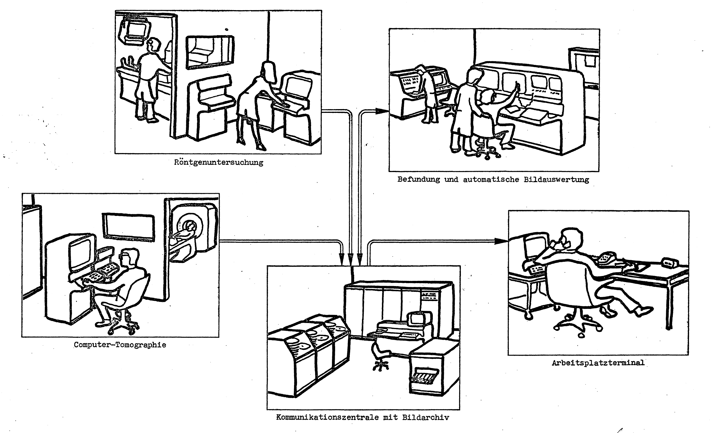
1973
Meyer-Ebrecht D. [Electronic Archival System for X-Rays Images - Work proposal for a research project in the
years 1974 and 1975] Elektronisches Archivierungssystem für Röntgenbilder – Arbeitsvorschlag für ein
Forschungsprojekt in den Jahren 1974 und 1975. Hamburg, Germany: Philips Research Labs; 1973 Oct.

Slide 15
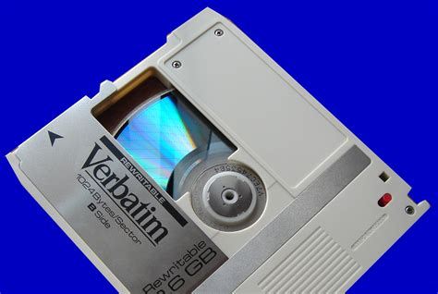

Slide 16
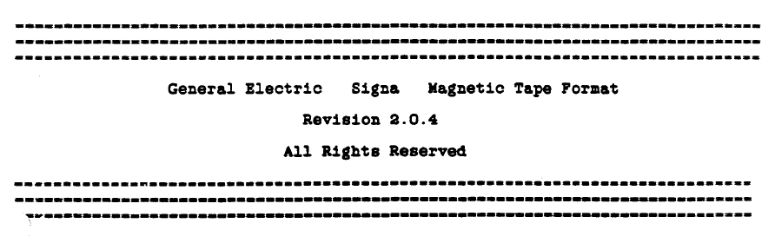

Slide 17
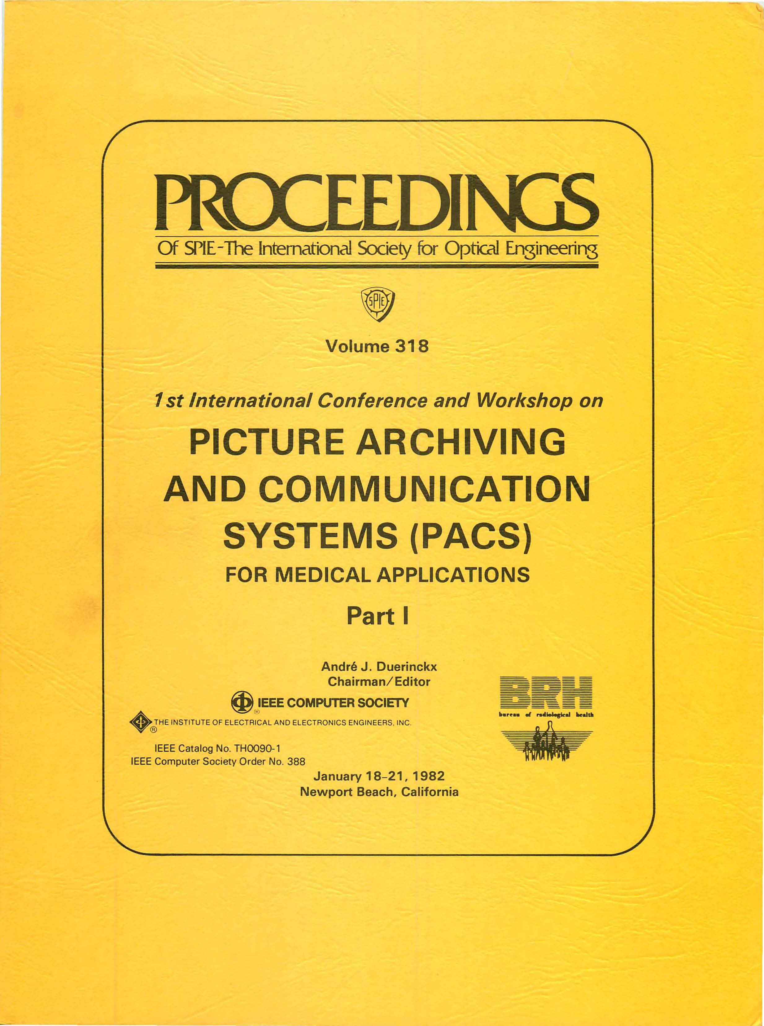
1982

Slide 18
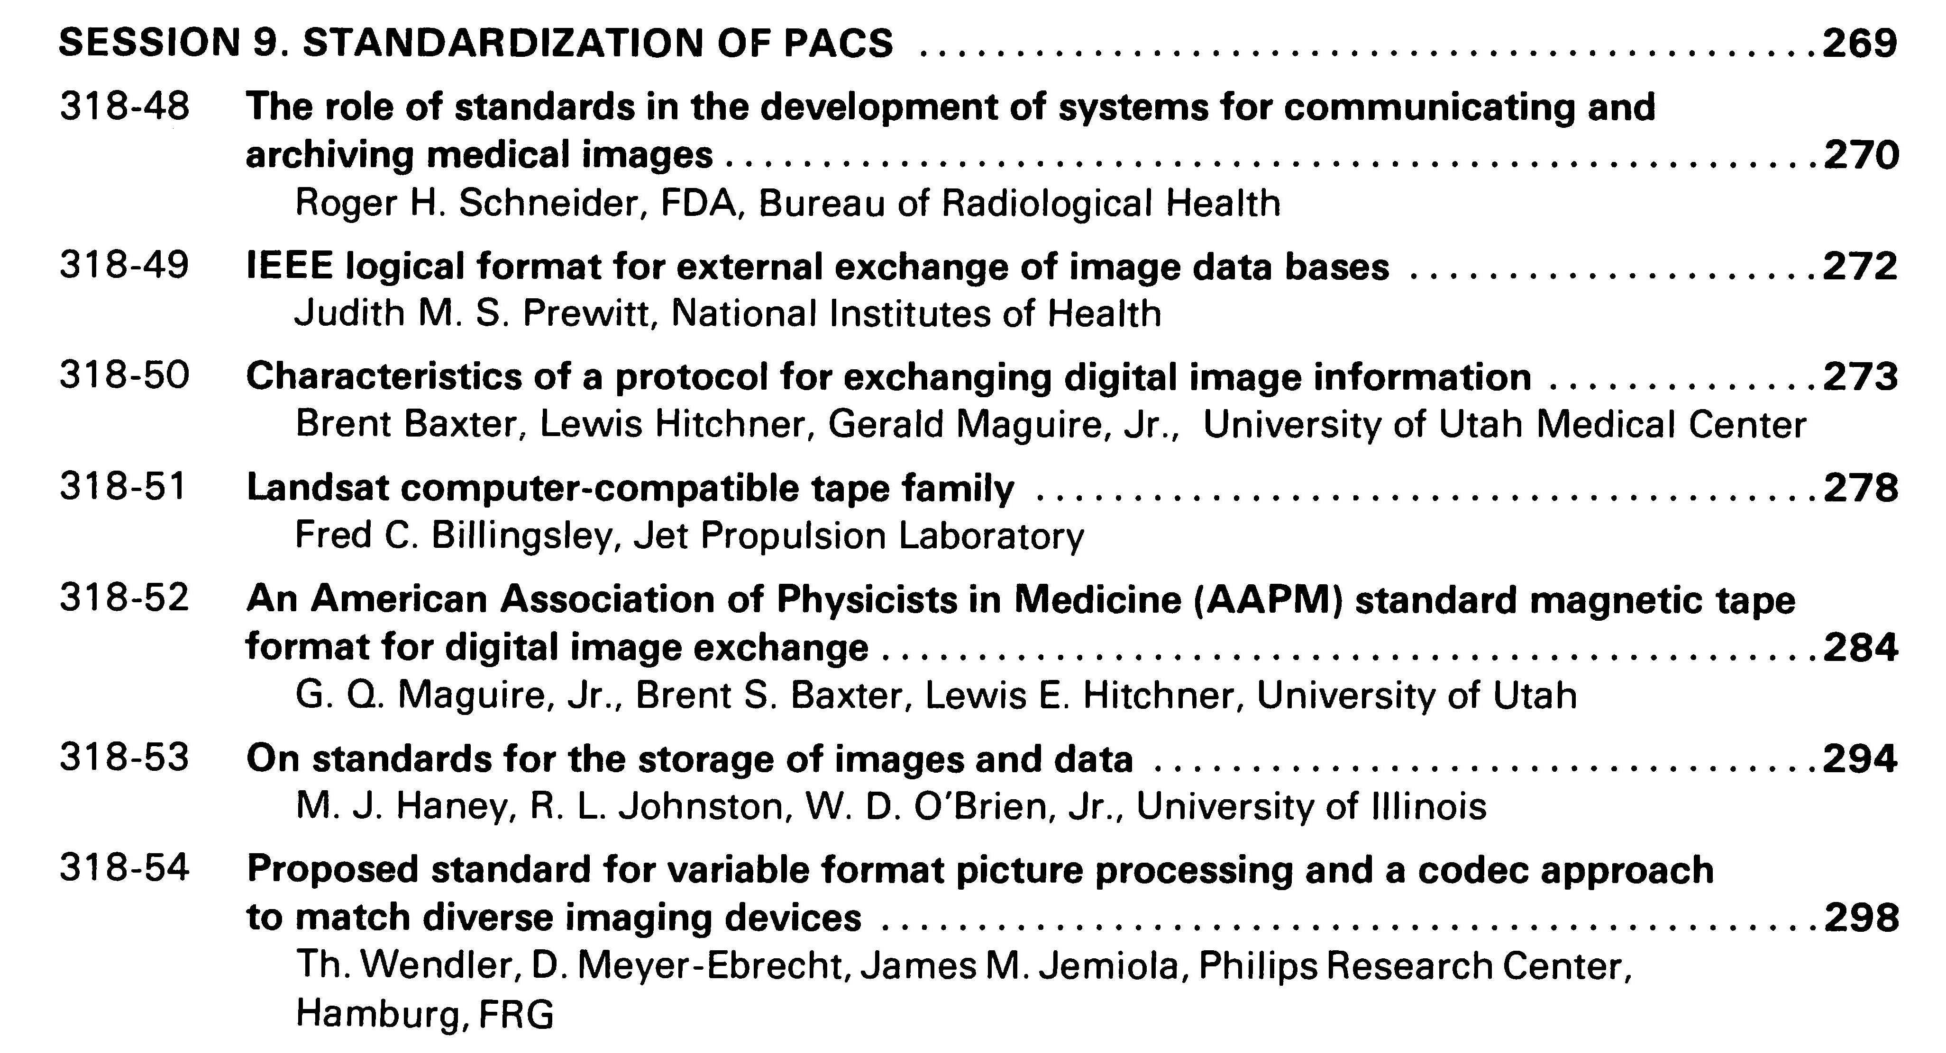
39 years ago – radiology PACS and DICOM ubiquitous 15-20 years later!

Slide 19
DICOM – Brief History
1982 – 1st PACS Conference – session on standards
1982 – AAPM Report 10 – Standard Format for Image Interchange
1983 – ad hoc meeting between FDA, ACR & NEMA
1983 – 1st meeting of ACR-NEMA “Digital Imaging and Communications Standards” Cmte
1985 – ACR-NEMA 300-1985 (“version 1.0”) issued
1988 – ACR-NEMA 300-1988 (“version 2.0”) issued
1990 – Inter-vendor testing of version 2.0 at Georgetown
1992 – Trial of DICOM (“version 3.0) at RSNA
1993 – DICOM 3.0 issued

Slide 20
DICOM – Brief History
1982 – 1st PACS Conference – session on standards
1982 – AAPM Report 10 – Standard Format for Image Interchange
1983 – ad hoc meeting between FDA, ACR & NEMA
1983 – 1st meeting of ACR-NEMA “Digital Imaging and Communications Standards” Cmte
1985 – ACR-NEMA 300-1985 (“version 1.0”) issued
1985 – IEEE 802.3 Ethernet (based on 1976 Metcalfe)
1986 – Aldus TIFF (version 3; prior versions drafts only)
1987 – CompuServe GIF
1988 – ACR-NEMA 300-1988 (“version 2.0”) issued
1990 – Inter-vendor testing of version 2.0 at Georgetown
1992 – Trial of DICOM (“version 3.0) at RSNA
1992 – JPEG (ITU T.81; ISO 10918-1 1994)
1993 – DICOM 3.0 issued

Slide 21
DICOM – Brief History
ACR-NEMA versions 1 and 2
50-pin 16 bit parallel interface
no network (assumed “network interface unit”)
layered
messages with commands and data
tag-value pairs
described patients, studies, images
described modality, acquisition, 3D position, etc.

Slide 22
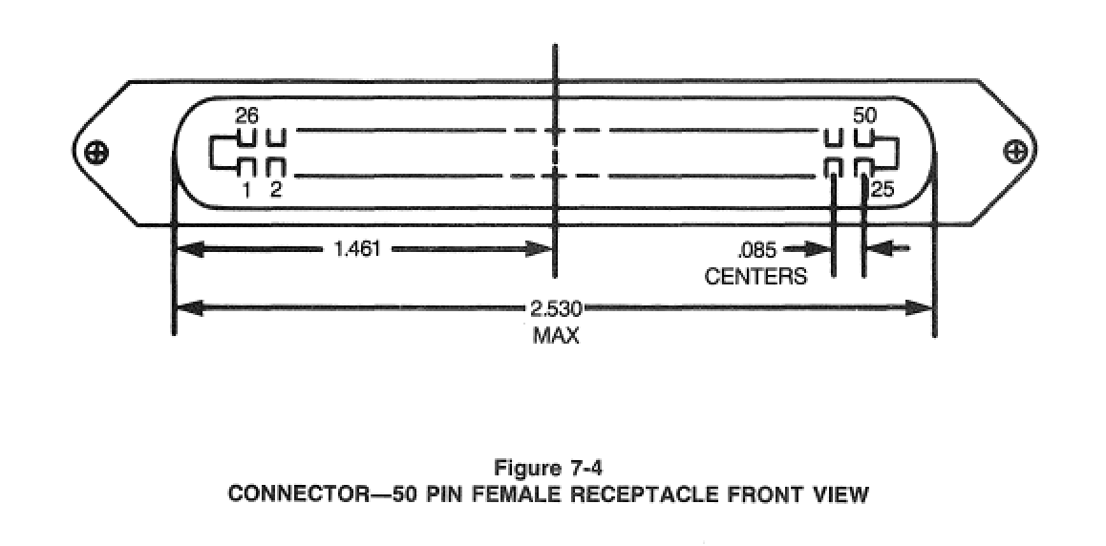
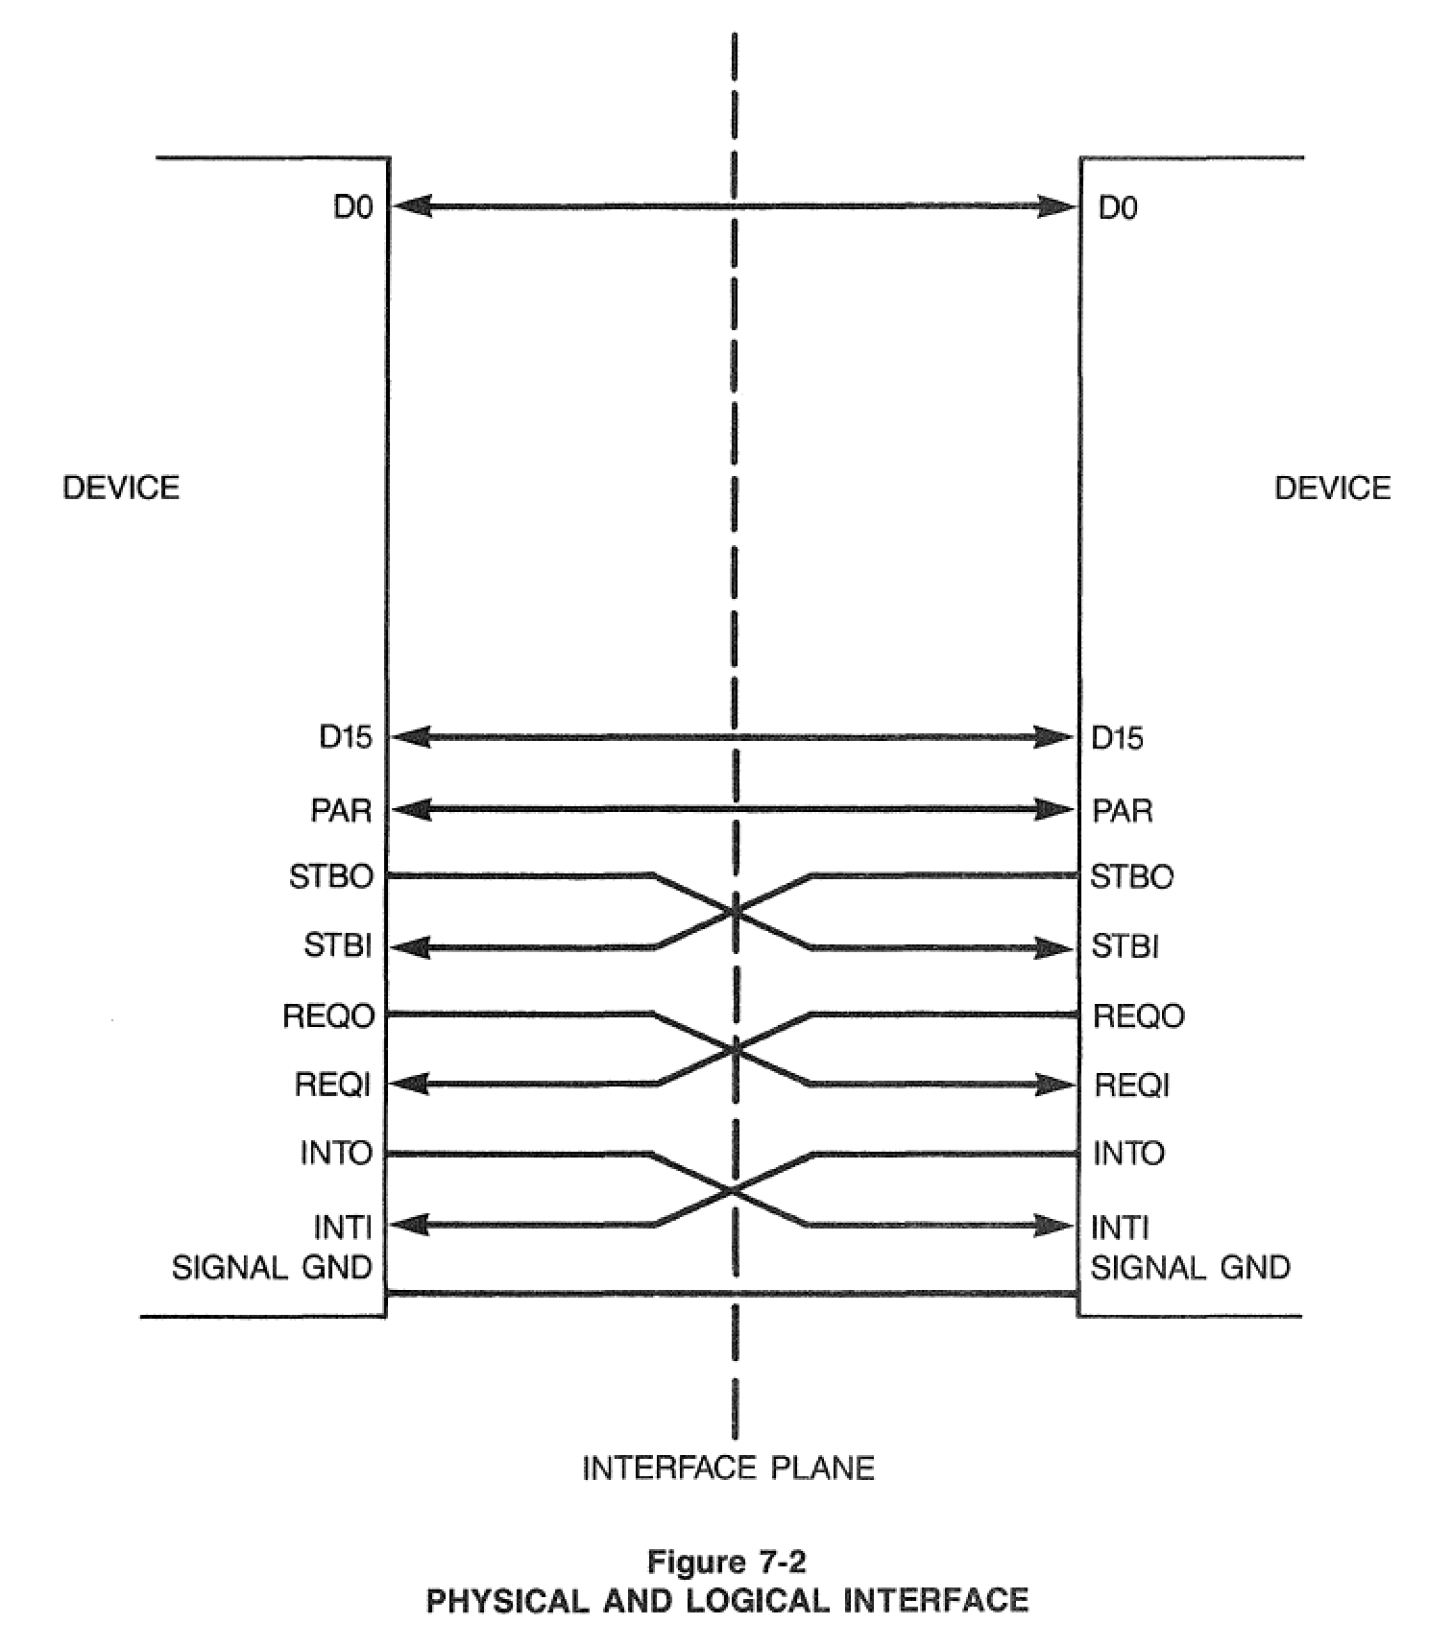
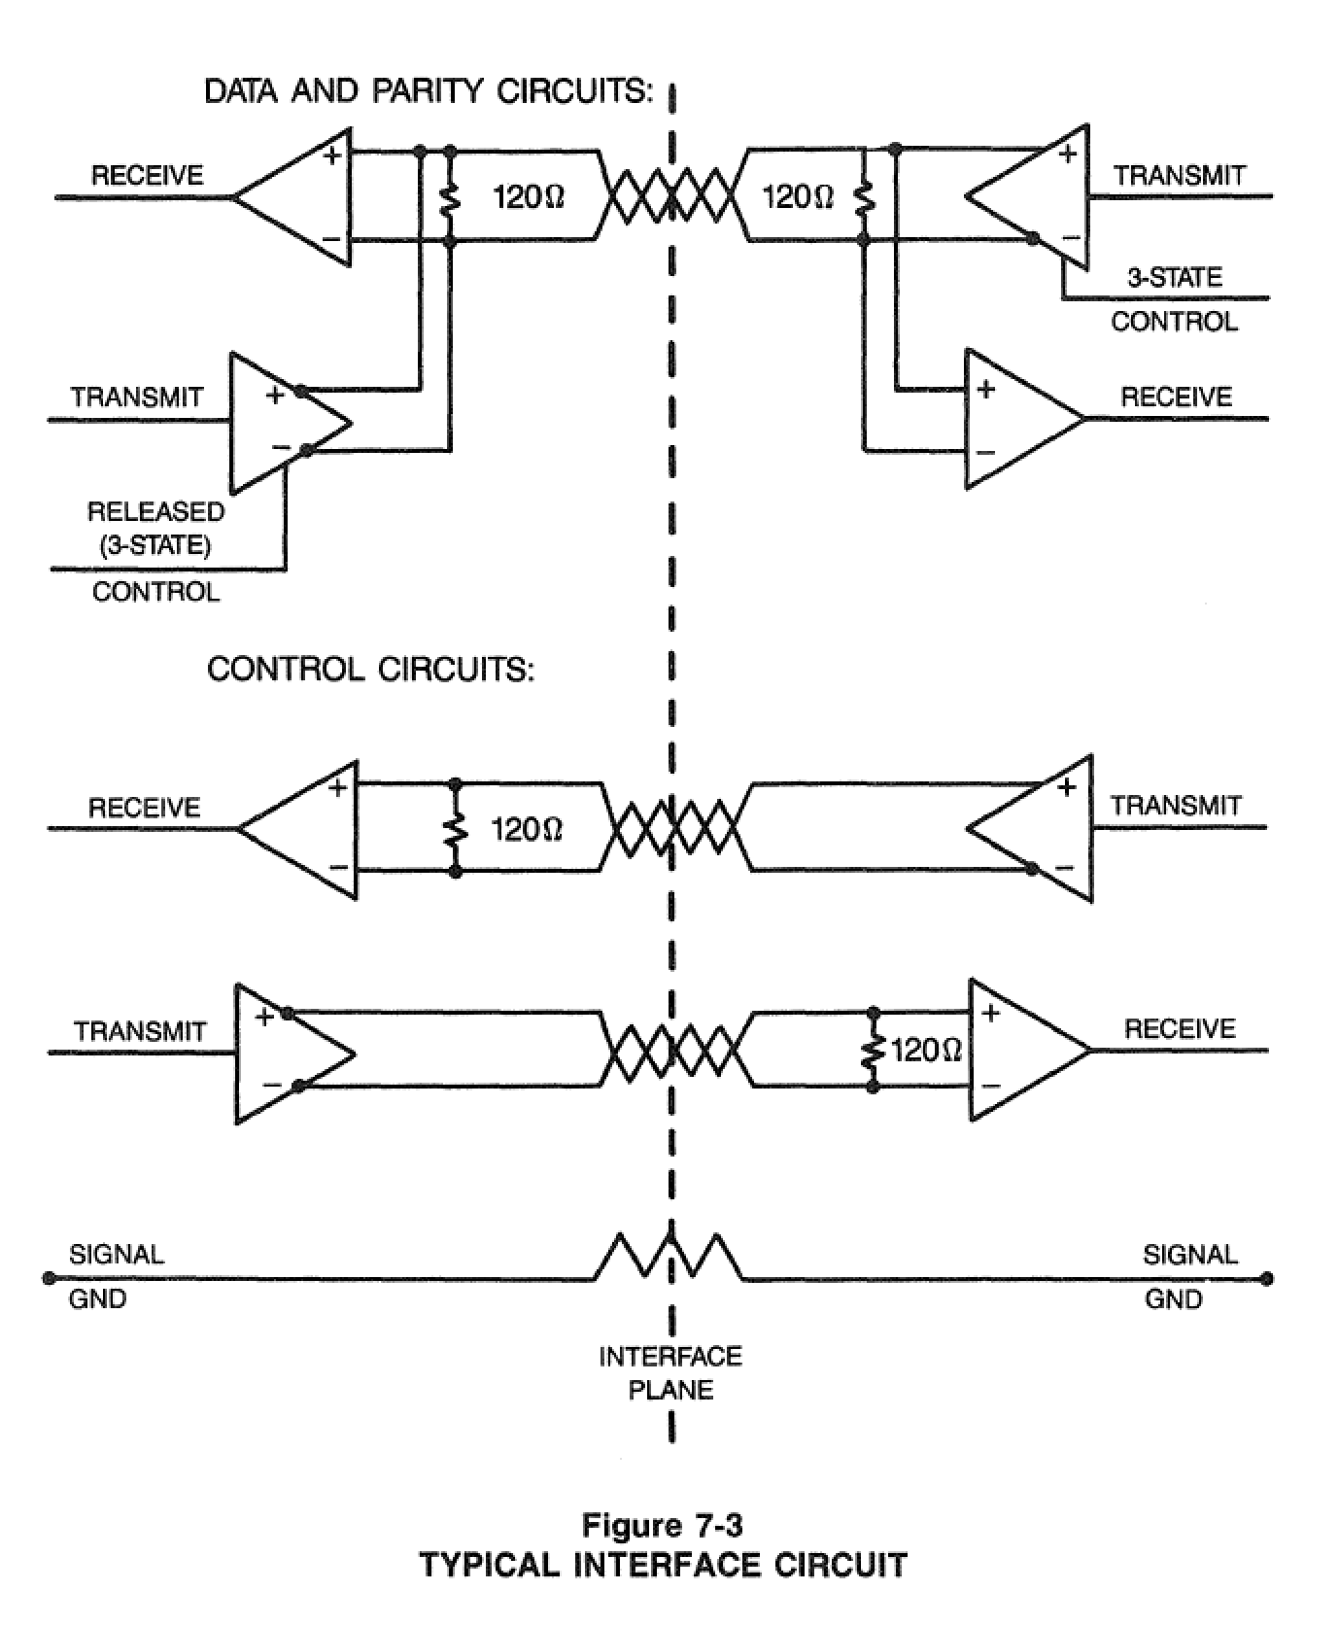

Slide 23
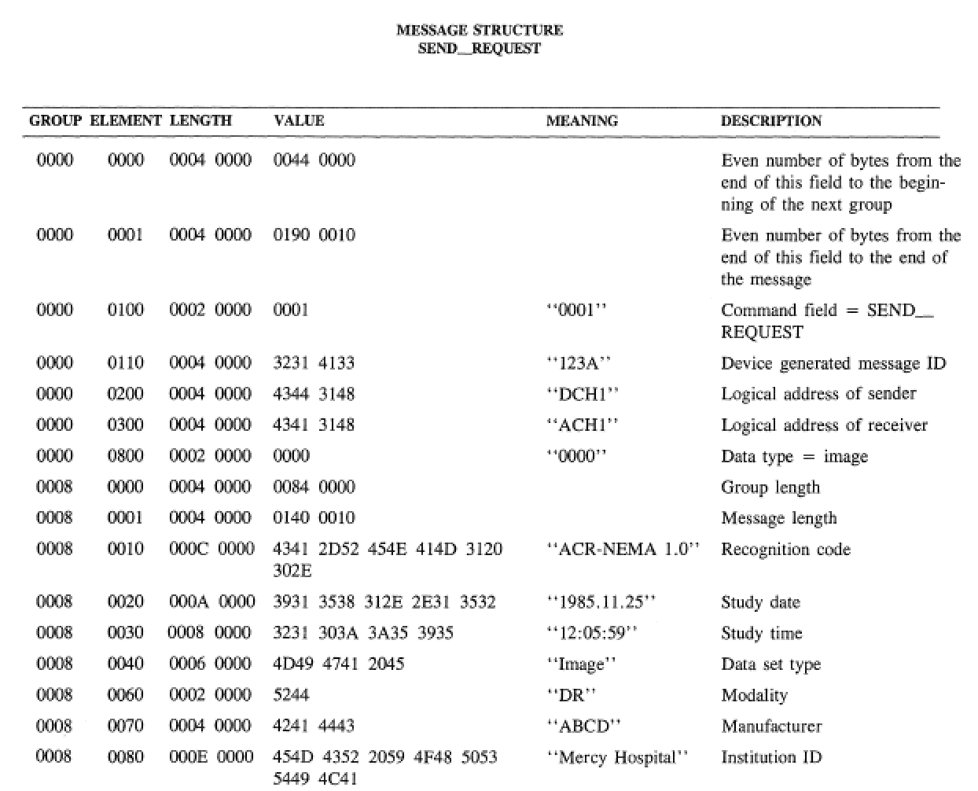

Slide 25
DICOM – Brief History
ACR-NEMA versions 1 and 2
50-pin 16 bit parallel interface
no network (assumed “network interface unit”)
layered
messages with commands and data
tag-value pairs
described patients, studies, images
described modality, acquisition, 3D position, etc.
DICOM “3.0”
TCP/IP network protocol (and OSI semantics)
“object-oriented” description & conformance

Slide 26
How DICOM differs (as a file format)
DICOM dataset (PACS, message) embedded in file wrapper (PS3.10)
Clinical, acquisition and modality-specific information model
"Attributes" of "Modules" of "Information Objects" aka. metadata
Metadata to identify and describe
Metadata is embedded in each and every file
E.g., PatientName, PatientID (MRN)
Each dataset (file, instance) given a globally Unique Identifier (UID)
Grouping – commonality of higher level entity UIDs (Study, Series)

Slide 27
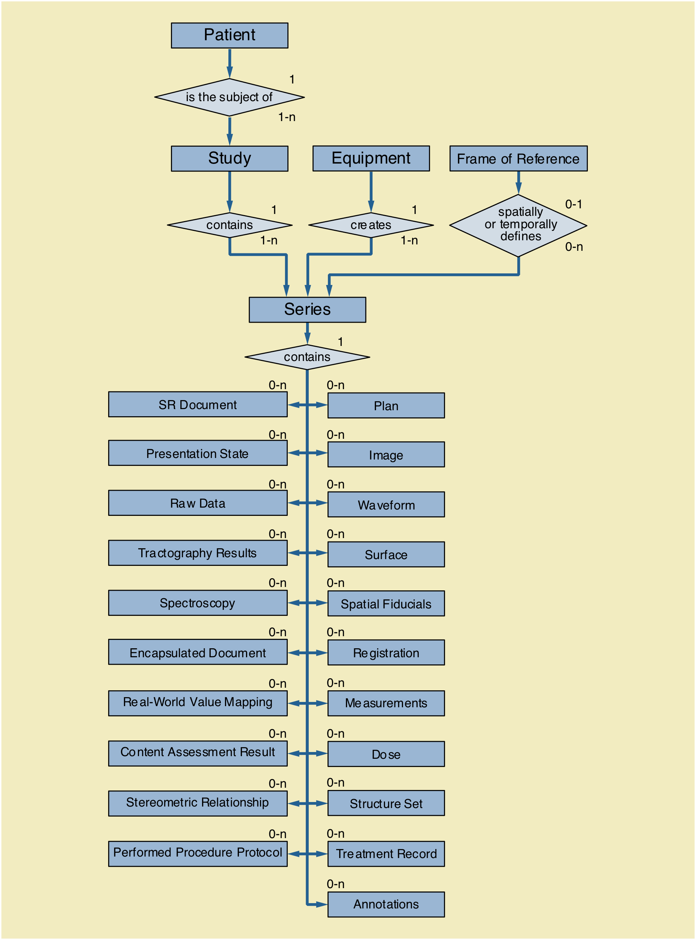

Slide 28
What DICOM inherited from legacy formats
Major scanner vendors already had proprietary MR & CT formats
GE Genesis (and others)
Siemens & Philips – Standard Product Interconnect (SPI) – ACR-NEMA based
…
One instance (file) per reconstructed slice
Binary fixed layout or tag-value pair stream
Header usually embedded with pixel data
Composite entities – patient, study, acquisition, series, instance data
What was available from operator or pulse sequence and parameters
In general, predated "volume" acquisitions (or use cases for 3D)

Slide 29
Trying to do better – Enhanced MultiFrame
DICOM Sup 49 Enhanced MR Image Storage SOP Class (2002)
Allow multiple slices in one dataset (file)
Mechanism to factor out commonality of per-slice description
Make many more acquisition-related attributes mandatory
Make many more values standard codes (e.g., acquisition contrast)
More precise definition of timing (e.g., for perfusion)
Explicit specification of Dimensions (e.g., space, time, B value)
Separate quantitation from rendering pipeline (RWV from Windowing)
Miserable failure (MR) – significant adoption by only one vendor
Core of all new IODs, including segmentation, parametric maps

Slide 30
A s s o c i a t i o n
DB
DB
DB
DB
UIDs
Store, parse, check
C-Store request
Dataset (attributes+pixels)
C-Store response (acknowledgement)

Slide 31
Multi-frame Functional Groups
Shared attributes
Per-frame attributes
Pixel data

Slide 32
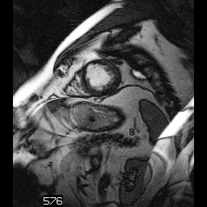
Trigger Delay Time
Temporal Position Index
Stack ID = 1
Dimension Index Values
2
\
1
\
5
48 ms
2
5
2\1\5
4
2\1\4
3
2\1\3
2
2\1\2
1
2\1\1
In-Stack Position
Dimension Index Pointers:
Temporal Position Index
Stack ID
In-Stack Position
Stack ID = 1
Time (1)
0 ms
1
5
1\1\5
4
1\1\4
3
1\1\3
2
1\1\2
1
1\1\1
Space (2)
In-Stack Position

Slide 33
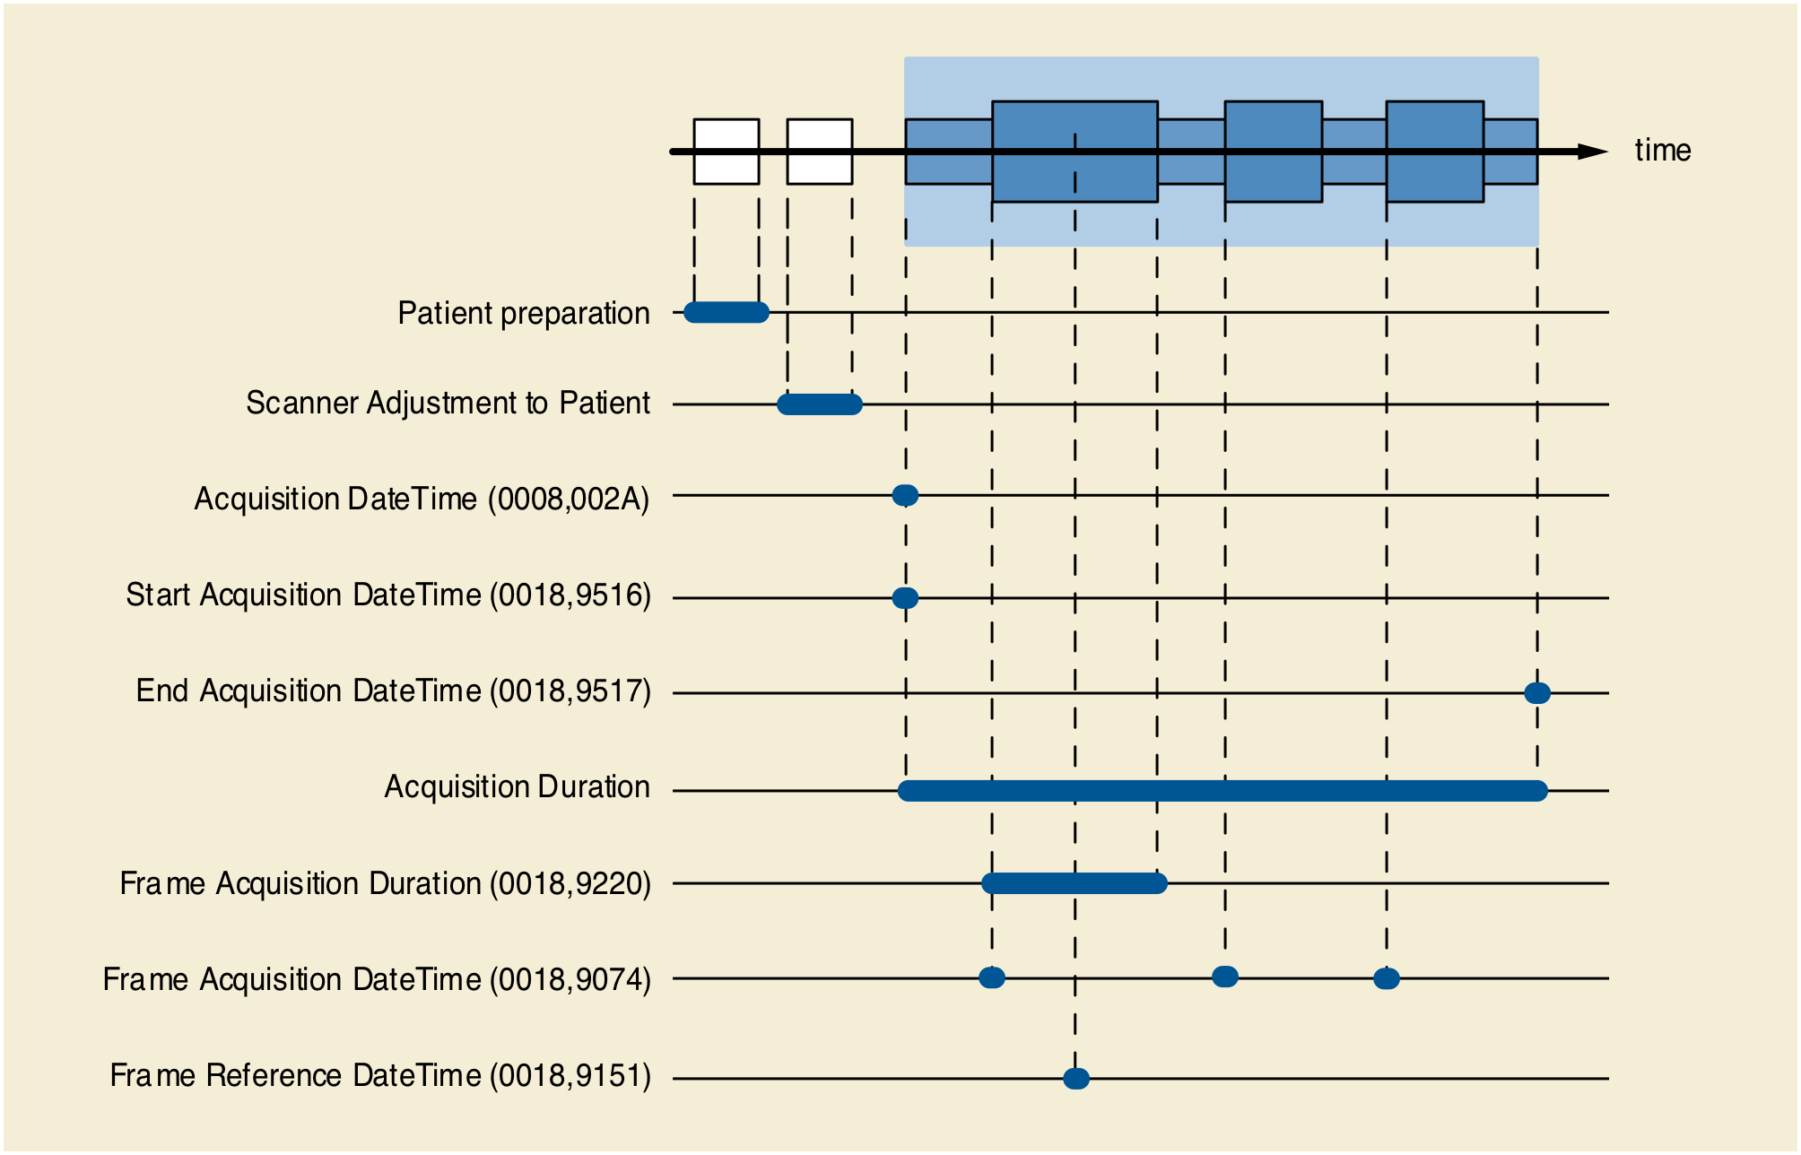

Slide 34
Real World Value Mapping
VOI
P
Modality
Display
LUT
LUT
LUT
Stored
Values
Real world
Real
value
Value
Value
Unit
LUT
Real World
Real World
Measurement
Value LUT
or
Value Intercept
Units Code
Data
and Slope
Sequence
(0040,9212)
attributes
(0040,08EA)

Slide 35
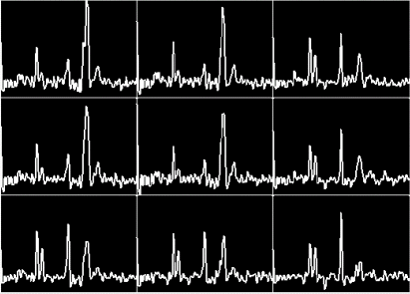
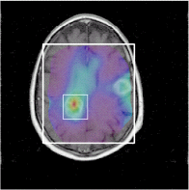
MR Spectroscopy
Storage of Spectroscopy Data
Metabolite Maps

Slide 36
MR Raw Data
Email from me to NEMA dated 1993/05/16:
"It just occurred to me that the MR module in proposed DICOM 3 makes no provision for transferring the raw data."
"Now, I know that most manufacturers don't make this quite as easy to get at as the image data, but it is there and many people use it, so DICOM might as well make provision for it. This would in no way oblige manufacturers to provide it along with everything else but would make it easy for those who wanted to (key selling feature to MR physicists here). Also it would be handy for vendors implementing remote diagnostics over a network link to a DICOM compatible machine rather than through a modem hidden in a cabinet)."

Slide 37
MR Raw Data
Not addressed in DICOM 3.0 1993
Nobody interested when followed up in 1995
By 2002 (Sup 49), consensus to encapsulate as private data elements
Raw Data IOD
traditional patient/study/series/equipment information model attributes
no standard payload – private elements for bulk raw data & its descriptors
not modality-specific (i.e., can use for CT, PET, etc.)
"The Raw Data stored with the Raw Data Module consists of one or more private attributes that are vendor specific. No rules are specified about the content and format of the raw data."

Slide 38
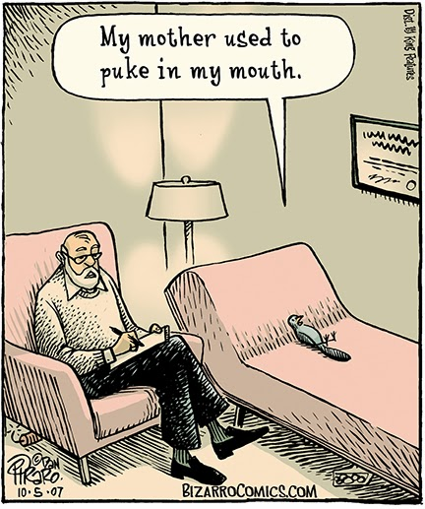
Store and Regurgitate

Slide 39
MR Raw Data
Store and regurgitate has limited utility beyond archival
Researchers would obviously prefer interoperable raw data
Vendors (at least in DICOM WG 16) remain uninterested
ISMRM Raw Data (ISMRMRD) a promising start
Disappointing that ISMRMRD is not DICOM-based
Contrast with DICOM-CT-PD (projection data) developed by CT physicists for use of raw data for reconstruction challenges

Slide 40


Slide 41
Quantitation and AI
Historically, many MR applications have been quantitative
Results have rarely been persisted in DICOM standard form
Screenshots saved as DICOM for human visualization
Useless semantically (not machine readable or re-usable)
Surge of (renewed) interest in AI is a new market force
Processed +/- annotated data of value for training/testing/reporting
Revitalized interest in historic and more recent DICOM mechanisms
Viewer ability to superimpose (beyond PET), e.g., parameter, heatmap
*Integration with clinical PACS using DICOM format, protocol, services

Slide 42
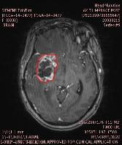
DICOM encoding of ROIs
Private elements
evil & must be stopped
Curves in image
weak semantics, old, retired
Overlays in image
weak semantics
Presentation States
weak semantics, PACS favorite
Structured Reports
best choice, but more work
RT Structure Sets
coordinates only
Segmentations
per-voxel ROIs; use with SR
Date | Volume | Auto LD | Auto SD
20021207 | 27080 | 49 | 27
… | … | … | …

Slide 43
DICOM encoding of ROI Annotations
Private elements
evil & must be stopped
Curves in image
weak semantics, old, retired
Overlays in image
weak semantics
Presentation States
weak semantics, PACS favorite
Structured Reports
best choice, but more work
RT Structure Sets
coordinates only
Segmentations
per-voxel ROIs; use with SR
Date | Volume | Auto LD | Auto SD
20021207 | 27080 | 49 | 27
… | … | … | …

Slide 44
DICOM and Annotations
Relatively new things in DICOM
Real World Value Maps
coded way to describe voxel values (beyond Rescale Type)
retrofitted to all existing DICOM images
form of “annotation” that makes pixel values semantically meaningful
Parametric Maps
RWVM combined with floating point or scaled integer pixels
Second-generation Radiotherapy annotations
Conceptual Volumes – “grammar” for combining contours, segmentations

Slide 45
DICOM and Annotations
Related DICOM IODs
Fiducials
markers with shape and location
Registration
rigid
deformable
well-known frames of reference (e.g., atlases)

Slide 46
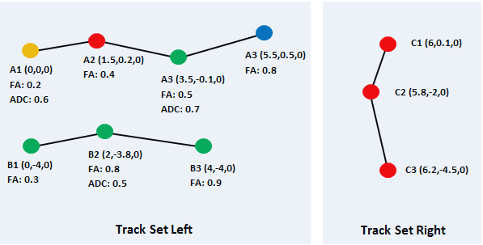
DICOM Tractography
Encoding of tracks by 3D coordinates
Coded description of what they are (anatomy)
Measurements at (subset of) points

Slide 47


Slide 48
DICOM Evolves
New and updated IODs and Attributes for new technology
"Woefully archaic" (Merck 2017)
New protocols – DICOMweb (http RESTful)
New representations – XML and JSON metadata
New compression schemes (still frame and video)
New data types for bulk data – floating point pixels
New object types – parametric maps, tractography, EEG
New security mechanisms – JWT, BCP 195 (TLS)

Slide 49
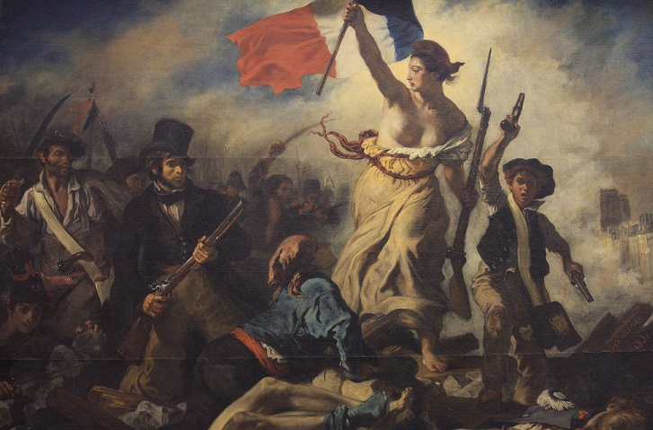

Slide 50



Slide 51
Future Direction of DICOM
DICOM could continue to be extended indefinitely
incrementally, as historically
backward compatibility has long been #1 priority
DICOM could be completely reconceived
new information model
new protocols and API
new representations
Does being completely different but solving the same problems add value?
Do solutions for any "new" problems actually require new standard?
E.g., high speed parallel read/write of bulk (pixel) data in cloud?
N5/Zarr style fragmentation of bulk data and separation from metadata

Slide 52
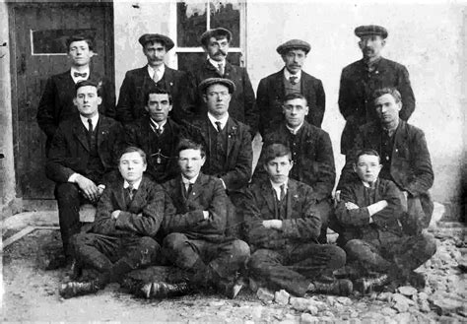
Notes:
https://carndonaghheritage.com/colgan-hall-colgan-hall-first-committee/

